Slide 1

BUSINESS INTELLIGANCE
MICROSOFT POWER BI PROJECT
Presented By
Aniruddha Deshmukh

Slide 2
Introduction to BI
The data of US Supplier “East Shore Supper Shop” Deals With the Technology ,Furniture's , Office Appliances .
The data is presented in an Excel format and includes information on customer areas and product purchases. The purpose of this analysis is to gain insights into the performance of the company and identify areas for improvement.
The data shows the different data are as follow
Customer id ,Area , Product , Rate , Discount , Profit ,
Date of Purchase ,Sub Type Of Product

Slide 3
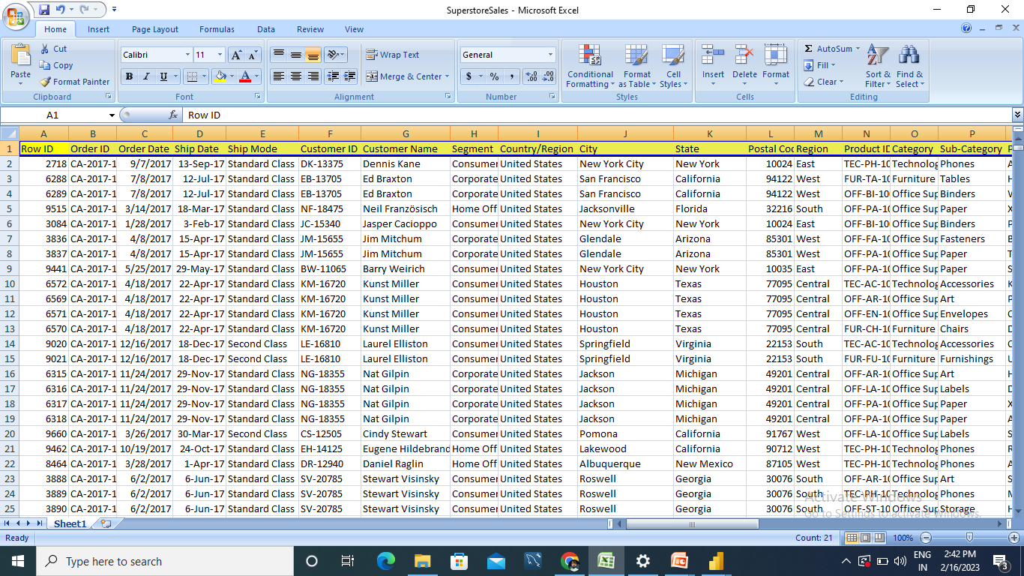
DATA SET OVERVIEW

Slide 4
Phases of BI
Business Intelligence 1.0 - Management software that integrates applications to manage and automate aspects of a business. Technique become marketable through the use of batch processing reporting.
Business Intelligence 2.0 -Added more speed to BI development and saw a concentration of BI in the hands of IBM, Microsoft, SAP and Oracle. Adding new method s of using data, algorithms ,machining learning, improved visualizations which change way of data view .
Business Intelligence 3.0 -Standard for large enterprise, from finance and banking to IT and communications. Across multiple devices and use visual. This approach is based on social workgroups and supports self-guided content creation, delivery, analysis and management.

Slide 5
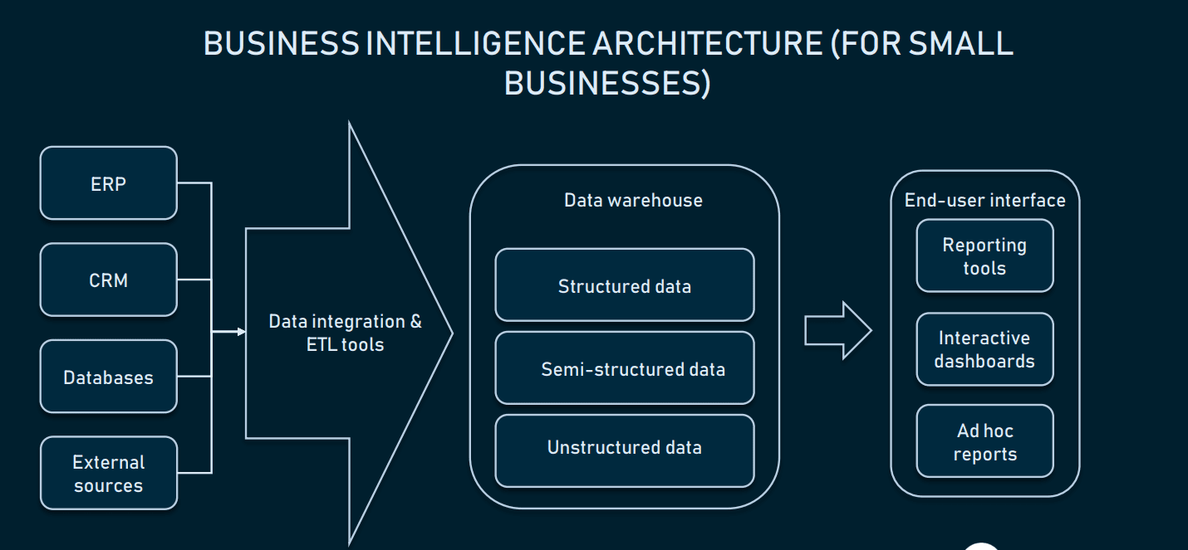
Architecture of BI
Business intelligence architecture is a term used to describe standards and policies for organizing data with the help of computer-based techniques and technologies that create business intelligence systems used for online data visualization, reporting, and analysis.

Slide 6
Layers of BI
ETL (Extract-Transform-Load) Layer:-This layer focuses on three main processes:Extraction, transformation and loading. Extraction is the process of identifying and collecting relevant data from different sources .
Data Warehouse Layer :-There are three components in the data warehouse layer, namely operational data store, data warehouse, and data marts. Data flows from operational data store to data warehouse and subsequently to data
Mart.
Metadata Layer:-Metadata refers to data about data. It describes where data are being used and stored, the source of data, what changes have been made to the data, and how one piece of data relates to other information.
End User Layer:-The end user layer consists of tools that display information in different formats to different users.

Slide 7
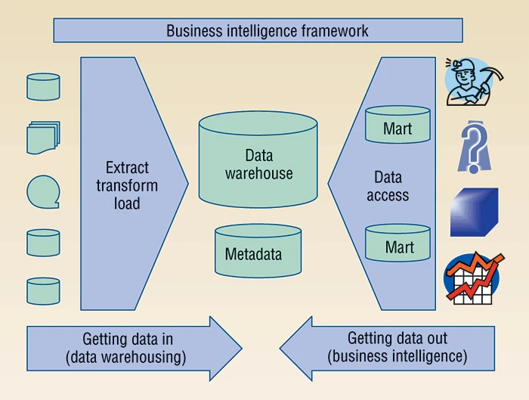
Frame Work and components of BI

Slide 8
Components
Data warehouse : Holds data obtained from internal sources as well as external sources. The internal sources include various operational systems.
Business analytics : Creates a report as and when required through queries and rules. Data mining is also another important aspect of business analytics.
Business performance : Management is a linkage of data with business objectives for efficient tracking. This business performance is then broadcasted to an executive decision-making body through dashboards and share-point.

Slide 9
Competitors and Vendors of BI
Tableau
Microsoft- Power bi
Birst
IBM
Micro Strategy
Oracle
SAP
SAS
Sisense
Tibco
Salesforce.

Slide 10
Challenges of BI
Lack of BI Strategy.
Lack of Training & Execution.
Rapidly growing volume of data.
Rapidly changing technology.
Business Intelligence with unstructured data.
Need of specialization knowledge and training
Installation and Deployment.

Slide 11
Benefits of BI
Quick and accurate reporting.
Delivering business insights that add value to the businesses.
Improving data quality.
Enhancing operational data efficiency.
Achieving customer satisfaction.
Understanding market trends and improving decision making process.
Lower margins and increasing business revenues.

Slide 12
Applications of BI
Sales Intelligence
Visualization
Reporting
Performance Management
Decision making

Slide 13
THANK YOU

